Slide 1
Optimizing LAMMPS* for Intel® Xeon Phi™ Coprocessors
W. Michael Brown
HPC Life Sciences Architect/Engineer
August 17, 2014
* Other names and brands may be claimed as the property of others.

Slide 2
Legal Disclaimers
INFORMATION IN THIS DOCUMENT IS PROVIDED IN CONNECTION WITH INTEL PRODUCTS. NO LICENSE, EXPRESS OR IMPLIED, BY ESTOPPEL OR OTHERWISE, TO ANY INTELLECTUAL PROPERTY RIGHTS IS GRANTED BY THIS DOCUMENT. EXCEPT AS PROVIDED IN INTEL'S TERMS AND CONDITIONS OF SALE FOR SUCH PRODUCTS, INTEL ASSUMES NO LIABILITY WHATSOEVER AND INTEL DISCLAIMS ANY EXPRESS OR IMPLIED WARRANTY, RELATING TO SALE AND/OR USE OF INTEL PRODUCTS INCLUDING LIABILITY OR WARRANTIES RELATING TO FITNESS FOR A PARTICULAR PURPOSE, MERCHANTABILITY, OR INFRINGEMENT OF ANY PATENT, COPYRIGHT OR OTHER INTELLECTUAL PROPERTY RIGHT.
A "Mission Critical Application" is any application in which failure of the Intel Product could result, directly or indirectly, in personal injury or death. SHOULD YOU PURCHASE OR USE INTEL'S PRODUCTS FOR ANY SUCH MISSION CRITICAL APPLICATION, YOU SHALL INDEMNIFY AND HOLD INTEL AND ITS SUBSIDIARIES, SUBCONTRACTORS AND AFFILIATES, AND THE DIRECTORS, OFFICERS, AND EMPLOYEES OF EACH, HARMLESS AGAINST ALL CLAIMS COSTS, DAMAGES, AND EXPENSES AND REASONABLE ATTORNEYS' FEES ARISING OUT OF, DIRECTLY OR INDIRECTLY, ANY CLAIM OF PRODUCT LIABILITY, PERSONAL INJURY, OR DEATH ARISING IN ANY WAY OUT OF SUCH MISSION CRITICAL APPLICATION, WHETHER OR NOT INTEL OR ITS SUBCONTRACTOR WAS NEGLIGENT IN THE DESIGN, MANUFACTURE, OR WARNING OF THE INTEL PRODUCT OR ANY OF ITS PARTS.
Intel may make changes to specifications and product descriptions at any time, without notice. Designers must not rely on the absence or characteristics of any features or instructions marked "reserved" or "undefined". Intel reserves these for future definition and shall have no responsibility whatsoever for conflicts or incompatibilities arising from future changes to them. The information here is subject to change without notice. Do not finalize a design with this information.
The products described in this document may contain design defects or errors known as errata which may cause the product to deviate from published specifications. Current characterized errata are available on request.
Contact your local Intel sales office or your distributor to obtain the latest specifications and before placing your product order.
Copies of documents which have an order number and are referenced in this document, or other Intel literature, may be obtained by calling 1-800-548-4725, or go to: http://www.intel.com/design/literature.htm
Software and workloads used in performance tests may have been optimized for performance only on Intel microprocessors. Performance tests, such as SYSmark and MobileMark, are measured using specific computer systems, components, software, operations and functions. Any change to any of those factors may cause the results to vary. You should consult other information and performance tests to assist you in fully evaluating your contemplated purchases, including the performance of that product when combined with other products.
Intel does not control or audit the design or implementation of third party benchmarks or Web sites referenced in this document. Intel encourages all of its customers to visit the referenced Web sites or others where similar performance benchmarks are reported and confirm whether the referenced benchmarks are accurate and reflect performance of systems available for purchase.
Relative performance is calculated by assigning a baseline value of 1.0 to one benchmark result, and then dividing the actual benchmark result for the baseline platform into each of the specific benchmark results of each of the other platforms, and assigning them a relative performance number that correlates with the performance improvements reported.
SPEC, SPECint, SPECfp, SPECrate. SPECpower, SPECjAppServer, SPECjbb, SPECjvm, SPECWeb, SPECompM, SPECompL, SPEC MPI, SPECjEnterprise* are trademarks of the Standard Performance Evaluation Corporation. See http://www.spec.org for more information. TPC-C, TPC-H, TPC-E are trademarks of the Transaction Processing Council. See http://www.tpc.org for more information.
Hyper-Threading Technology requires a computer system with a processor supporting HT Technology and an HT Technology-enabled chipset, BIOS and operating system. Performance will vary depending on the specific hardware and software you use. For more information including details on which processors support HT Technology, see here
Intel® Turbo Boost Technology requires a Platform with a processor with Intel Turbo Boost Technology capability. Intel Turbo Boost Technology performance varies depending on hardware, software and overall system configuration. Check with your platform manufacturer on whether your system delivers Intel Turbo Boost Technology. For more information, see http://www.intel.com/technology/turboboost
No computer system can provide absolute security. Requires an enabled Intel® processor and software optimized for use of the technology. Consult your system manufacturer and/or software vendor for more information.
Intel processor numbers are not a measure of performance. Processor numbers differentiate features within each processor family, not across different processor families: Go to:
Learn About Intel® Processor Numbers
Intel product plans in this presentation do not constitute Intel plan of record product roadmaps. Please contact your Intel representative to obtain Intel’s current plan of record product roadmaps.
Copyright © 2014 Intel Corporation. All rights reserved. Intel, the Intel logo, Xeon and Intel Core are trademarks or registered trademarks of Intel Corporation or its subsidiaries in the United States and other countries. All dates and products specified are for planning purposes only and are subject to change without notice
*Other names and brands may be claimed as the property of others.

Slide 3
Risk Factors
The above statements and any others in this document that refer to plans and expectations for the third quarter, the year and the future are forward-looking statements that involve a number of risks and uncertainties. Words such as “anticipates,” “expects,” “intends,” “plans,” “believes,” “seeks,” “estimates,” “may,” “will,” “should” and their variations identify forward-looking statements. Statements that refer to or are based on projections, uncertain events or assumptions also identify forward-looking statements. Many factors could affect Intel’s actual results, and variances from Intel’s current expectations regarding such factors could cause actual results to differ materially from those expressed in these forward-looking statements. Intel presently considers the following to be the important factors that could cause actual results to differ materially from the company’s expectations. Demand could be different from Intel's expectations due to factors including changes in business and economic conditions; customer acceptance of Intel’s and competitors’ products; supply constraints and other disruptions affecting customers; changes in customer order patterns including order cancellations; and changes in the level of inventory at customers. Uncertainty in global economic and financial conditions poses a risk that consumers and businesses may defer purchases in response to negative financial events, which could negatively affect product demand and other related matters. Intel operates in intensely competitive industries that are characterized by a high percentage of costs that are fixed or difficult to reduce in the short term and product demand that is highly variable and difficult to forecast. Revenue and the gross margin percentage are affected by the timing of Intel product introductions and the demand for and market acceptance of Intel's products; actions taken by Intel's competitors, including product offerings and introductions, marketing programs and pricing pressures and Intel’s response to such actions; and Intel’s ability to respond quickly to technological developments and to incorporate new features into its products. The gross margin percentage could vary significantly from expectations based on capacity utilization; variations in inventory valuation, including variations related to the timing of qualifying products for sale; changes in revenue levels; segment product mix; the timing and execution of the manufacturing ramp and associated costs; start-up costs; excess or obsolete inventory; changes in unit costs; defects or disruptions in the supply of materials or resources; product manufacturing quality/yields; and impairments of long-lived assets, including manufacturing, assembly/test and intangible assets. Intel's results could be affected by adverse economic, social, political and physical/infrastructure conditions in countries where Intel, its customers or its suppliers operate, including military conflict and other security risks, natural disasters, infrastructure disruptions, health concerns and fluctuations in currency exchange rates. Expenses, particularly certain marketing and compensation expenses, as well as restructuring and asset impairment charges, vary depending on the level of demand for Intel's products and the level of revenue and profits. Intel’s results could be affected by the timing of closing of acquisitions and divestitures. Intel's results could be affected by adverse effects associated with product defects and errata (deviations from published specifications), and by litigation or regulatory matters involving intellectual property, stockholder, consumer, antitrust, disclosure and other issues, such as the litigation and regulatory matters described in Intel's SEC reports. An unfavorable ruling could include monetary damages or an injunction prohibiting Intel from manufacturing or selling one or more products, precluding particular business practices, impacting Intel’s ability to design its products, or requiring other remedies such as compulsory licensing of intellectual property. A detailed discussion of these and other factors that could affect Intel’s results is included in Intel’s SEC filings, including the company’s most recent reports on Form 10-Q, Form 10-K and earnings release.
Rev. 7/17/13

Slide 4
Optimization Notice
Optimization Notice
Intel's compilers may or may not optimize to the same degree for non-Intel microprocessors for optimizations that are not unique to Intel microprocessors. These optimizations include SSE2, SSE3, and SSE3 instruction sets and other optimizations. Intel does not guarantee the availability, functionality, or effectiveness of any optimization on microprocessors not manufactured by Intel. Microprocessor-dependent optimizations in this product are intended for use with Intel microprocessors. Certain optimizations not specific to Intel microarchitecture are reserved for Intel microprocessors. Please refer to the applicable product User and Reference Guides for more information regarding the specific instruction sets covered by this notice. Notice revision #20110804

Slide 5
Configuration Notes for Performance Measurements in this Talk

Slide 6
Endeavor† Cluster Node Configuration / Compilers
CPU: 2-socket/24 cores/48 threads
Processor: Intel® Xeon® processor E5-2697 V2 @ 2.70GHz (12 cores) with Intel® Hyper-Threading Technology⁴
Coprocessor: Intel® Xeon Phi™ coprocessor 7120P
61 cores @ 1.238 GHz, 4-way Intel® Hyper-Threading Technology, Memory: 15872 MB
Intel® Many-core Platform Software Stack Version 2.1.6720-19
Network: InfiniBand* Architecture Fourteen Data Rate (FDR)
Operating System: Red Hat Enterprise Linux* 2.6.32-358.el6.x86_64.crt1 #4 SMP Fri May 17 15:33:33 MDT 2013 x86_64 x86_64 x86_64 GNU/Linux
Memory: 64GB
LAMMPS Compilation Notes
Intel® Compiler 2013 SP1.1.106 (icc version 14.0.1)
Intel® MPI* 5.0.0.028
Single precision Intel® MKL FFTs
Compile flags: -O3 -xAVX -fno-alias -ansi-alias -restrict -DLAMMPS_MEMALIGN=64 -override-limits -offload-option,mic,compiler,"-fp-model fast=2 -mGLOB_default_function_attrs=\"gather_scatter_loop_unroll=4\""
† http://www.top500.org/system/176908
* Other names and brands may be claimed as the property of others.

Slide 7
Molecular Dynamics in a Nutshell

Slide 8
Classical Molecular Dynamics
Objective: Simulate the time evolution of a system of atoms or other particles
Input:
  Initial particle positions/velocities and other model-specific parameters (charge, type, rotation, bond topology, etc.)
  Equation for the energy of the system
  Boundary conditions (periodic, fixed, shrink-wrapped, reflecting, etc.)
  Ensemble to sample from
      Microcanonical (NVE) Ensemble – Energy/Volume constant, Pressure/Temp vary
      Canonical (NVT) Ensemble – Volume/Temp constant, Pressure/Energy vary
      Isothermal/Isobaric (NPT) Ensemble – Pressure/Temp constant, Volume/Energy vary
  Statistics computations and output

Slide 9
Basic MD Algorithm
For an iteration of the simulation,
  Calculate the force on each particle as the gradient of the energy with respect to position/rotation.
  Time integration to calculate the new positions/velocities of the particles with respect to the force
      May require calculation of temperature or pressure to adjust the velocities or simulation box size
  Calculation of relevant statistics
  Output of data and restart files

Slide 10
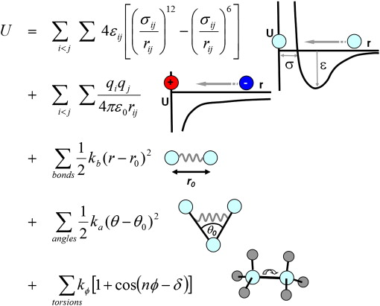
Energy of the System (Potential/Force Field)
Energy for classical molecular systems typically decomposed into:
  Non-bonded (van der Waals) energy caused by induced/fluctuating dipoles that occur as atoms approach each other
  Coulombic/electrostatic energy (from fitting force-field with static partial-charge on the atoms)
  Bonded interactions including stretching, angle, dihedral energies
  Functional form and parameters vary depending on the force-field
Note: The terms are independent allowing potential for task-based parallelism

Slide 11
Calculating the Energy/Forces (1)
Bonded interactions
  O(N)
  Typically a small fraction of the run time

Slide 12
Calculating the Energy/Forces (2)
van der Waals and electrostatic energies are due to interactions between all particles in the system
  Typically, for biological force fields, decomposed as a sum over the energy between all pairs in the system (2-body potential)
  For van der Waals with Lennard-Jones, energy falls off rapidly with distance (r^-6)
      Short-range problem
  For electrostatics, energy falls off slowly (r^-1)
      Long-range problem

Slide 13
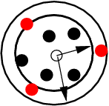
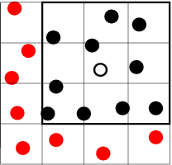
Short-range problem, O(N²) -> O(N)
Use a cutoff distance for van der Waals interactions such that the energy is 0 between atoms separated by a larger distance (cutoff distance)
Keep a list of atoms that might fall within the cutoff for each atom (Neighbor list)
  The list should include atoms at a distance further than the cutoff (skin distance) so that it does not need to be rebuilt every time step (typically every 10 timesteps)
      Bin the atoms into cells (cell list), O(N)
      For a given atom, check which atoms are within the cutoff+skin distance and add to list (verlet list), O(N)

Slide 14
Long-range Problem (1)
O(N^2) for all pairs…
    Not practical to evaluate due to slow decay of E(r) (remember periodic boundaries)
Instead, Ewald summation is used: split E into two functions, E_{r} and E_{k}
  E_{r} should be negligible beyond some cutoff distance
      Evaluate with short-range van der Waals
  E_{k} should be slowly varying at all distances
      Evaluate with Poisson summation using Fourier transform with few K-vectors
  E= E_{r} + E_{k}

Slide 15
Long-range Problem (2)
Ewald Summation
  Best implementations are O(N^3/2)
Particle-Mesh Methods
  Discretize the problem to allow for FFT use
  Smooth Particle Mesh Ewald (SPME) or Particle-Particle Particle-Mesh (P³M)
      Spread charges from atoms onto mesh
      Poisson solve (3D FFTs on mesh)
      Interpolate energy/force from mesh
  O(MlogM) for M mesh points (M ≈ N) is typical

Slide 16
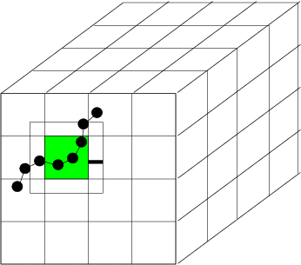
Basics on Parallelization
Distributed memory parallelization
  Typically a spatial decomposition where physical domain divided into subdomains, one per processor
  Each task computes forces on atoms in its subdomain using info from nearby tasks (atoms at the borders within the cutoff+skin [ghost atoms] are stored on both tasks)
  Atoms "carry along" molecular topology as they migrate to new tasks
Shared memory parallelization
  Can also use a spatial decomposition with data privatization
  Atom/force decompositions introduce data dependencies
    Tradeoffs between data privatization/redundant computation/atomics
    For example, if the number of active threads is small compared to the atom count, shared, data privatization w/ reduction can be used (each thread uses its own array for the force)
    If the number of threads is large, redundant computation can be used
      Ignore the fact that we only have to compute the energy/force/virial term once for each pair of atoms.
      Double the size of the neighbor list so that if atom a is in b’s neighbor list, b is also in a’s.
      The result of this is double the computation for energies/forces/virials
      Removes all memory conflicts for force updates
      Approach used in GPU implementations

Slide 17
LAMMPS* in a Nutshell
Large-scale Atomic/Molecular Massively Parallel Simulator
  http://lammps.sandia.gov
  Lead developer: Steve Plimpton, Sandia National Laboratories
* Other names and brands may be claimed as the property of others.

Slide 18
LAMMPS*
Classical Molecular Dynamics Package
  C++, GPL License, Build as Library for use in other Codes, Stand-alone executable, or script through Python*
  32K downloads, 8K mail list postings, > 5000 citations
  Popular due to its versatility for supporting a wide range of simulation types, potentials, etc. and for the ease with which new features can be added
  >500K lines of code
  Scalable performance with MPI*/OpenMP* and a variety of long-range solver options
    Ewald, Particle-Particle Particle-Mesh with several variants, Multilevel Summation
* Other names and brands may be claimed as the property of others.

Slide 19
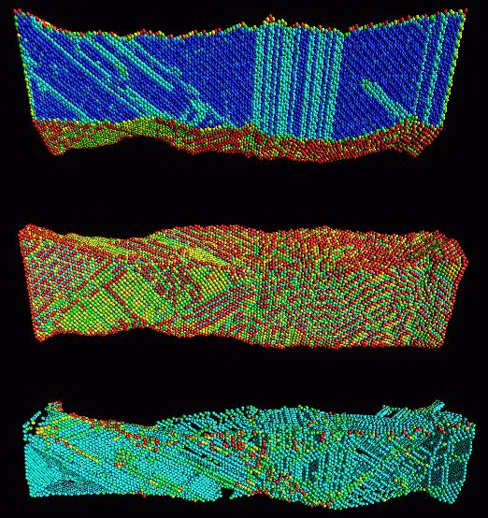
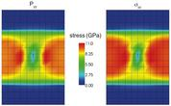
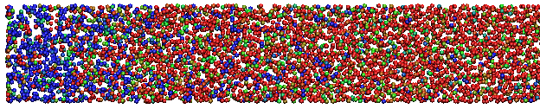
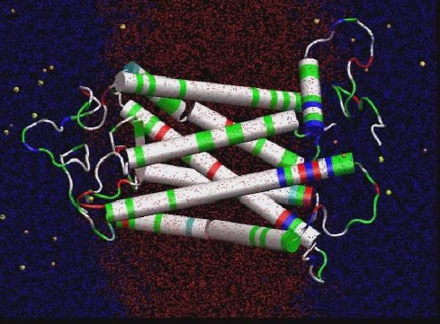
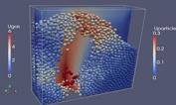
LAMMPS* Potentials/Force-Fields
Biomolecules:
  CHARMM*, AMBER*, OPLS, COMPASS (class 2), long-range Coulombics via PPPM, point dipoles, ...
Polymers:
  all-atom, united-atom, coarse-grain (bead-spring FENE), bond-breaking, …
Materials:
  EAM and MEAM for metals, Buckingham, Morse, Yukawa, Stillinger-Weber, Tersoff, COMB, SNAP, ...
Chemistry:
  AI-REBO, REBO, ReaxFF, eFF
Mesoscale:
  granular, DPD, Gay-Berne, colloidal, peridynamics, DSMC...
Hybrid:
  can use combinations of potentials for hybrid systems: water on metal, polymers/semiconductor interface, colloids in solution, …
Solid Mechanics
Materials Science
Chemistry
Granular Flow
Biophysics
* Other names and brands may be claimed as the property of others.

Slide 20
Modularity in LAMMPS*
LAMMPS Objects
atom styles: atom, charge, colloid, ellipsoid, point dipole
pair styles: LJ, Coulomb, Tersoff, ReaxFF, AI-REBO, COMB, MEAM, EAM, Stillinger-Weber,
fix styles: NVE dynamics, Nose-Hoover, Berendsen, Langevin, SLLOD, Indentation,...
compute styles: temperatures, pressures, per-atom energy, pair correlation function, mean square displacements, spatial and time averages
Goal: All computes work with all fixes work with all pair styles work with all atom styles
* Other names and brands may be claimed as the property of others.

Slide 21
Simulation Profile for Rhodopsin Benchmark in LAMMPS*
Simulates the movement of a protein in the retina that plays an important role in the perception of light
Simulation is in a solvated lipid bilayer using the CHARMM* force field
  Particle-Particle Particle-Mesh
  SHAKE* constraints
  Temperature is 300K
  Pressure of 1 atm
Software and workloads used in performance tests may have been optimized for performance only on Intel microprocessors. Performance tests, such as SYSmark and MobileMark, are measured using specific computer systems, components, software, operations and functions. Any change to any of those factors may cause the results to vary. You should consult other information and performance tests to assist you in fully evaluating your contemplated purchases, including the performance of that product when combined with other products. See benchmark tests and configurations in the speaker notes. For more information go to http://www.intel.com/performance
* Other names and brands may be claimed as the property of others.

Slide 22
Intel® Package for LAMMPS
* Other names and brands may be claimed as the property of others.

Slide 23
Objectives
Modify compute intensive routines to support vectorization
  Increasingly important for power-efficient performance on new hardware
Add support for single precision and mixed precision calculations in addition to full double precision
  Reduces random-access memory latencies, doubles the vector width, and allows for fast transcendentals on Intel® Xeon Phi™ coprocessors with use of the Quadratic Minimax Polynomial approximation
Add support for offload to Intel® Xeon Phi™ coprocessors
  Exploit power-efficient many-core processors on HPC clusters with scalable performance
…
  Future enhancements planned
* Other names and brands may be claimed as the property of others.

Slide 24
Intel® Package Optimizations (1)
Align all important memory allocations (and thread offsets into shared allocations) to 64B boundaries
Vectorization performance is better for aligned data
Data transfer between the host memory and coprocessor is faster for aligned data
Eliminates false sharing between multiple threads
Accomplished in LAMMPS* with the pre-existing LAMMPS_MEMALIGN preprocessor define for heap allocations and __declspec(align(64)) for important allocations on stack.
* Other names and brands may be claimed as the property of others.

Slide 25
Intel® Package Optimizations (2)
Add additional new buffers for atom data (position, type, forces, energies, torques, virials, etc.) that support single, mixed, and double precision, allow for easy offload, and support efficient vectorization.
There is a penalty for packing/casting the data every timestep, but:
  Mixed precision is faster because it uses single precision for most calculations but double precision for error-sensitive operations/variables such as accumulation
  Eliminating fragmentation and pointer chasing in memory allocations makes offload easier
  Storing atom data as {x, y, z, type} rather than {x, y, z} allows for more efficient vectorization with random-access for Intel® Xeon® processors with Intel®Advanced Vector Extensions (AVX) and keeps the data for an atom on a single cache line.
  Duplicate force/energy arrays allows for overlapping the calculations for different force-field terms with concurrent calculations on the host and coprocessor
* Other names and brands may be claimed as the property of others.

Slide 26
Intel® Package Optimizations (3)
Modify the code to allow the compiler to vectorize important routines
Use the -opt-report compiler options to get information about what the compiler does for specific loops
Use the #pragma simd directive to help the compiler in loops with data dependencies
  Vectorization of the pairwise force inner-loops (loop over neighbors for a single atom) is guaranteed not to result in memory collisions in molecular dynamics because you will never have the same atom (memory location) more than once in a neighbor list
  Need to use a reduction clause to simd to tell the compiler to add the results for the energy/virial terms together into a single memory location at the end of the loop
* Other names and brands may be claimed as the property of others.

Slide 27
Intel® Package Optimizations (4)
Modify the code to allow the compiler to vectorize important routines
Vectorization for Intel® Xeon® processors and Intel® Xeon Phi™ coprocessors can result in different code for masking out computations within conditional branches
  For compiler vectorization in MD for Intel® AVX, it can be more efficient to zero out atoms outside the cutoff explicitly rather than using large conditional regions
If the number of loop iterations (trip count) is not an even multiple of the vector width, separate code will be executed to handle the last iteration of the vectorized loop (the loop remainder)
  In a few cases, this remainder code can be very inefficient
    New versions of Intel® VTune™ Amplifier will tell you about this
  In LAMMPS*, the neighbor list is padded to be a multiple of the vector width with an extra atom that is guaranteed to never be within the cutoff of any other atom
* Other names and brands may be claimed as the property of others.

Slide 28
Intel® Package Optimizations (5)
Modify the code to support offload to the coprocessor with offload directives
Offload neighbor-list build and short-range force computation
  Routines that dominate simulation profile and have a high degree of concurrency that can be parallelized.
  Avoid having to transfer neighbor list data every timestep
Use the CPUs and the coprocessors and exploit the fact that different terms in the force-field are independent
  Support offloading a fraction of the neighbor-list build and force calculation – use the CPUs for part of the computation too.
    Asynchronous (non-blocking) data transfer and offload with the signal clause.
    Use the same C++ routine for execution on the CPU and the coprocessor with the if clause.
    Exploit independent force-field calculations by making the offload concurrent with bonded terms, long-range calculations, and some MPI* communications
* Other names and brands may be claimed as the property of others.

Slide 29
Intel® Package Optimizations (6)
Use thread affinity on the coprocessor to allow for arbitrary MPI*/OpenMP* configurations.
KMP_PLACE_THREADS + MIC_ENV_PREFIX or kmp_set_affinity_mask_proc
Divide up the hardware threads between the MPI tasks running on each node and assign a unique set to each MPI task
Avoid doing memory allocation on coprocessor within a loop
Allocate once and grow only if necessary using the alloc_if and free_if clauses
Avoid unnecessary repeated data transfers within a loop
For constant atom data such as charge and type, only transfer if the atom list has changed (nocopy/length) clause
* Other names and brands may be claimed as the property of others.

Slide 30
Intel® Package Offload Simulation Profile
Rhodopsin benchmark scaled to 256K atoms
Y-axis is time
The colors in the CPU and Coprocessor columns at any one time represent the simultaneous operations on the CPU and the coprocessor
24 MPI tasks, each using 10 threads on coprocessor
  2S Intel® Xeon® processor E5-2697 v2 + Intel® Xeon Phi™ coprocessor 7120A
Software and workloads used in performance tests may have been optimized for performance only on Intel microprocessors. Performance tests, such as SYSmark and MobileMark, are measured using specific computer systems, components, software, operations and functions. Any change to any of those factors may cause the results to vary. You should consult other information and performance tests to assist you in fully evaluating your contemplated purchases, including the performance of that product when combined with other products. See benchmark tests and configurations in the speaker notes. For more information go to http://www.intel.com/performance
* Other names and brands may be claimed as the property of others.

Slide 31
Advantages of Intel® Package vs GPU Package (1)
Support for simulation in triclinic boxes
Same code for routines run on the CPU and coprocessor (with or without offload)
  Optimizations for Intel® Xeon Phi™ coprocessors resulted in faster performance on Intel® Xeon® processors (up to 3.5X)
  GPU package uses different algorithms and different code/language
Support for both ‘newton’ settings allows for more flexibility for new force-fields
Improved flexibility for heterogeneous calculations
  Intel® Xeon Phi™ offload not limited to 16 MPI* tasks on CPU (CUDA*-MPS limitation)
  Intel® package supports OpenMP* with multiple threads on the CPU (GPU package does not use OpenMP)
  MPI* tasks sharing coprocessor are able to get exclusive core affinity
* Other names and brands may be claimed as the property of others.

Slide 32
Advantages of Intel® Package vs GPU Package (2)
More options for overlap of MPI* communications and computation
Build process is simpler and does not require building a separate library for coprocessor routines
  One compiler/Makefile for everything
Precision mode (single, mixed, or double) can be switched at run-time without rebuilding
Package written in standard C++ with OpenMP*
  Offload directives used for the coprocessor
* Other names and brands may be claimed as the property of others.

Slide 33
Performance results with the Intel® Package

Slide 34
Rhodopsin Protein Scaled to 512K Atoms
Simulates the movement of a protein in the retina that plays an important role in the perception of light
Simulation is in a solvated lipid bilayer using the CHARMM* force field
  Particle-Particle Particle-Mesh
  SHAKE* constraints
  Temperature is 300K
  Pressure of 1 atm
Available in LAMMPS* repository
Software and workloads used in performance tests may have been optimized for performance only on Intel microprocessors. Performance tests, such as SYSmark and MobileMark, are measured using specific computer systems, components, software, operations and functions. Any change to any of those factors may cause the results to vary. You should consult other information and performance tests to assist you in fully evaluating your contemplated purchases, including the performance of that product when combined with other products. See benchmark tests and configurations in the speaker notes. For more information go to http://www.intel.com/performance
* Other names and brands may be claimed as the property of others.

Slide 35
Liquid Crystal Benchmark
  Biaxial Ellipsoidal Liquid Crystal Mesogens with 2:1.5:1 Aspect Ratio and Mass of 1.5 (Reduced Units)
  Initial equilibration in the isothermal-isobaric ensemble to reach reduced temperature of 2.4 and pressure of 8.0 followed by 50 timestep benchmark run in microcanonical ensemble
  Cutoff = 4.0, Skin = 0.8 (Reduced Units)
  Based on simulations from:
    Brown, W.M., Petersen, M.K., Plimpton, S.J., Grest, G.S. Liquid Crystal Nanodroplets in Solution. Journal of Chemical Physics. 2009. 130: p. 044901 (1-7).
  Available in LAMMPS* repository
Software and workloads used in performance tests may have been optimized for performance only on Intel microprocessors. Performance tests, such as SYSmark and MobileMark, are measured using specific computer systems, components, software, operations and functions. Any change to any of those factors may cause the results to vary. You should consult other information and performance tests to assist you in fully evaluating your contemplated purchases, including the performance of that product when combined with other products. See benchmark tests and configurations in the speaker notes. For more information go to http://www.intel.com/performance
* Other names and brands may be claimed as the property of others.

Slide 36
Progress by Other Teams for Molecular Dynamics on Intel® Xeon Phi™ Coprocessors

Slide 37
Amber* 14
Application: Amber*
Description:
  Bimolecular Simulations (Protein, DNA, RNA, virus etc.). Full double precision (DPDP)
Availability:
  As a patch of Amber 14 when user updates Amber (http://ambermd.org/bugfixes14.html, http://ambermd.org/bugfixesat.html) Update 5 and update 8.
  Recipe available: Section 18.7 of the manual http://ambermd.org/doc12/Amber14.pdf
Usage Model:
  Baseline is on Intel® Xeon® CPU only (SNB EP performance also measured in http://ambermd.org/gpus/benchmarks.htm#Benchmarks ) & speedup is shown with offload processing on both Xeon & Xeon Phi. Performance shown is for the released code. This is all double precision code, across the platforms.
  Highlights:
  The code had been optimized, delivered to the Amber community (whoever has license) and available as update patch during code configuration.
  Results:
  Optimized Xeon ® CPU + Xeon Phi ™ coprocessor offload demonstrated 2X improved performance over baseline CPU only code.
Code Optimization Strategy:
  1) Optimized data decomposition between host and Xeon Phi™ coprocessor. 2) Reducing data transfer between host and coprocessor 3) Reducing Launch time to coprocessor 4) Xeon Phi™ coprocessor parallel computation with reciprocal force 5) avoid lookup table to increase cache locality 6) Efficient vectorization of force loop and neighbor list 7) Optimum OpenMP* scheduling.
Notes:
  News about the release is in the website: http://ambermd.org/. Recipe is in the amber manual for anyone to download.
  Baseline 2S Intel® Xeon® processor E5-2697 v2
  Optimized 2S Intel® Xeon® processor E5-2697 v2
  Optimized 2S E5-2697 v2 + Intel® Xeon Phi™ coprocessor 7120A
Config. Summary
ICC/IFORT 14.0 U1 MPI 4.1.1.036
MPSS 3.2.3
ECC on,
Turbo on Xeon
Turbo off Xeon Phi 7120A
Software and workloads used in performance tests may have been optimized for performance only on Intel microprocessors. Performance tests, such as SYSmark and MobileMark, are measured using specific computer systems, components, software, operations and functions. Any change to any of those factors may cause the results to vary. You should consult other information and performance tests to assist you in fully evaluating your contemplated purchases, including the performance of that product when combined with other products. See benchmark tests and configurations in the speaker notes. For more information go to http://www.intel.com/performance
* Other names and brands may be claimed as the property of others.

Slide 38
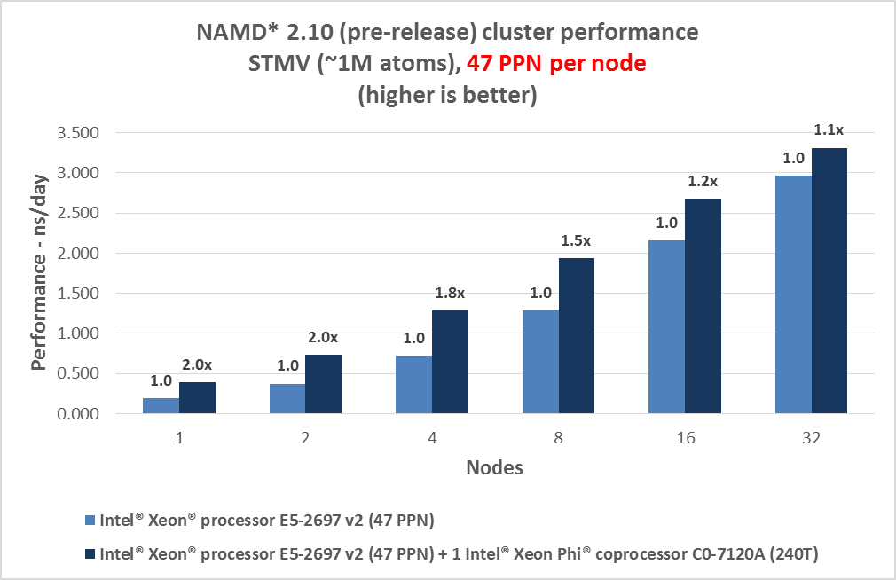
NAMD* 2.10 pre-release
Application & workload: NAMD* 2.10 pre-release; STMV
Description:
  A parallel, object-oriented molecular dynamics code designed for high-performance simulation of large biomolecular systems
Availability:
  Intel® Xeon Phi™ coprocessor support is available as pre-release at http://www.ks.uiuc.edu/Development/Download/download.cgi?PackageName=NAMD. Use the nightly build.
Usage Model:
  Single rank on host with 47 threads. Various computations are offloaded to Intel® Xeon Phi™ coprocessor from each thread.
Highlights:
  Intel® Xeon Phi™ coprocessor support is now in the development branch of NAMD 2.10 pre-release.
Results:
  For the STMV workload, a single Intel® Xeon Phi™ coprocessor continues to provide acceleration up to 32 nodes.
Code Optimization Strategy:
  Pairlist padding, atom sorting, AoS vs SoA (AoS is used), r2_table calculation instead of lookup, mixture of gathers and loadunpacks + transforms, force combining (force updates at the same time so indexes/masks can be reused), mixed precision, selectively load balancing the non-bonded work between the host and device, intrinsics used for both force computation and pairlist generation loops, dynamic scheduling in OpenMP* parallel for loops, computes are sorted based on “input distance.”
Notes:
  We are continuing to optimize NAMD* further. This TR will be updated as newer results are available.
Cluster benchmark (STMV)
Software and workloads used in performance tests may have been optimized for performance only on Intel microprocessors. Performance tests, such as SYSmark and MobileMark, are measured using specific computer systems, components, software, operations and functions. Any change to any of those factors may cause the results to vary. You should consult other information and performance tests to assist you in fully evaluating your contemplated purchases, including the performance of that product when combined with other products. See benchmark tests and configurations in the speaker notes. For more information go to http://www.intel.com/performance
* Other names and brands may be claimed as the property of others.

Slide 39
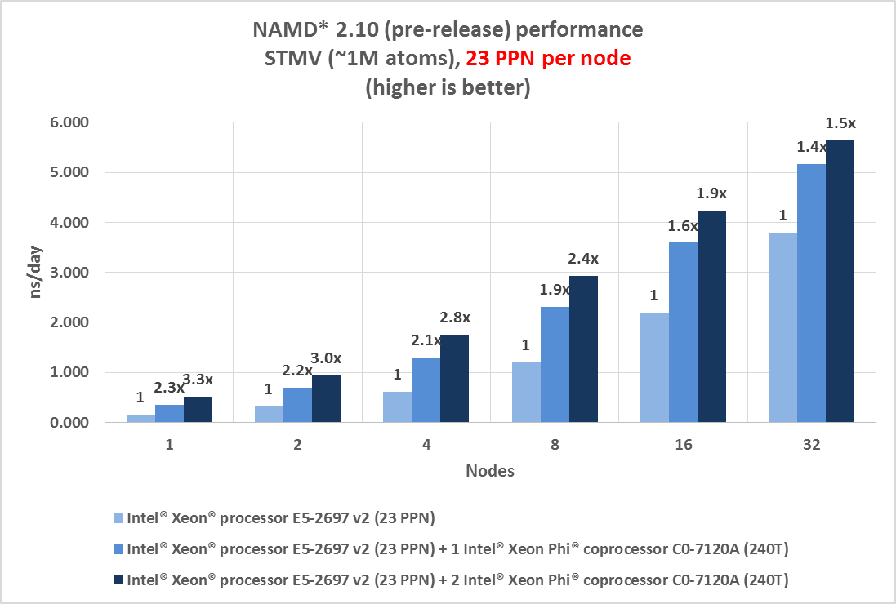
NAMD* 2.10 pre-release
Application & workload: NAMD* 2.10 pre-release; STMV
Description:
  A parallel, object-oriented molecular dynamics code designed for high-performance simulation of large biomolecular systems
Availability:
  Intel® Xeon Phi™ coprocessor support is available as pre-release at http://www.ks.uiuc.edu/Development/Download/download.cgi?PackageName=NAMD. Use the nightly build.
Usage Model:
  Single rank on host with 23 threads. Various computations are offloaded to Intel® Xeon Phi™ coprocessor from each thread.
Highlights:
  Intel® Xeon Phi™ coprocessor support is now in the development branch of NAMD 2.10 pre-release.
Results:
  For the STMV workload, a single and dual Intel® Xeon Phi™ coprocessors continue to provide acceleration up to 32 nodes.
Code Optimization Strategy:
  Pairlist padding, atom sorting, AoS vs SoA (AoS is used), r2_table calculation instead of lookup, mixture of gathers and loadunpacks + transforms, force combining (force updates at the same time so indexes/masks can be reused), mixed precision, selectively load balancing the non-bonded work between the host and device, intrinsics used for both force computation and pairlist generation loops, dynamic scheduling in OpenMP* parallel for loops, computes are sorted based on “input distance.”
Notes:
  We are continuing to optimize NAMD* further. This TR will be updated as newer results are available.
Cluster benchmark (STMV)
Software and workloads used in performance tests may have been optimized for performance only on Intel microprocessors. Performance tests, such as SYSmark and MobileMark, are measured using specific computer systems, components, software, operations and functions. Any change to any of those factors may cause the results to vary. You should consult other information and performance tests to assist you in fully evaluating your contemplated purchases, including the performance of that product when combined with other products. See benchmark tests and configurations in the speaker notes. For more information go to http://www.intel.com/performance
* Other names and brands may be claimed as the property of others.

Slide 40
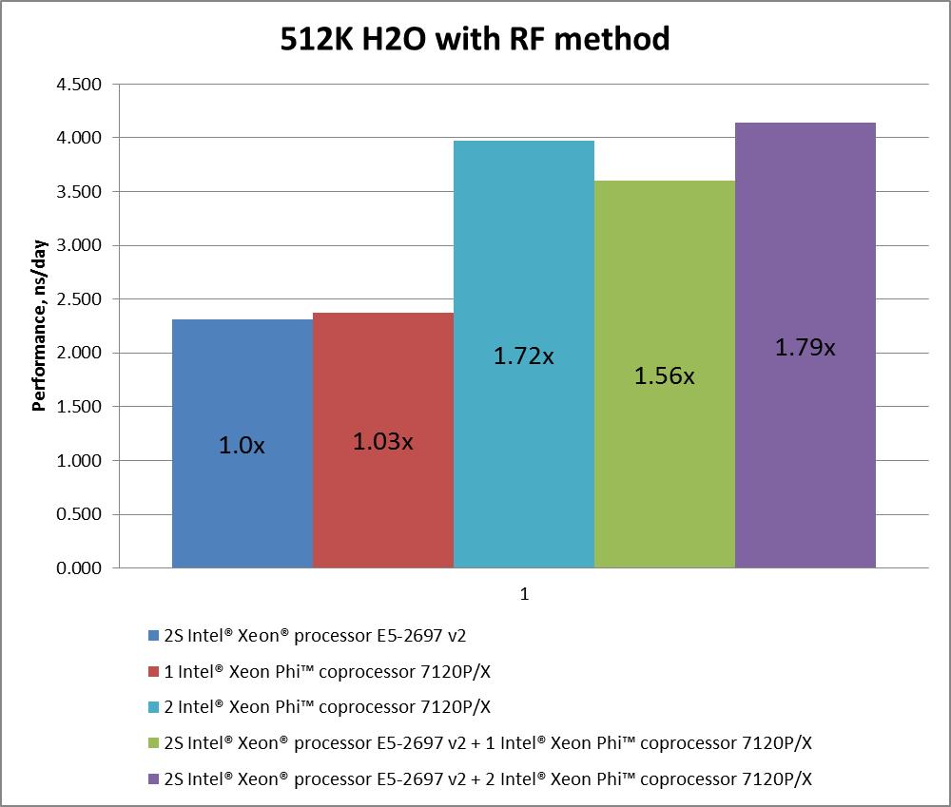
GROMACS*
Application: GROMACS* 5.0-RC1
Description:
    GROMACS is a versatile package to perform molecular dynamics, i.e. simulate the Newtonian equations of motion for systems with hundreds to millions of particles. It is one of the fastest and the most popular molecular dynamics packages
Workload: 512K H₂O with RF method
Availability:
    VERSION 5.0-rc1 is available from http://www.gromacs.org/Downloads &
        ftp://ftp.gromacs.org/pub/gromacs/gromacs-5.0-rc1.tar.gz
Results:
    Highly optimized for Intel® Xeon® Processors
    (AVX-intrinsics)
    Able to run full simulation on Intel® Xeon Phi™ coprocessor natively + host processor using a symmetric model
    Optimized with intrinsics for 512-bit vectorization
    on Intel Xeon Phi coprocessors
Code Optimization Strategy:
  Several experiments were done to find optimal MPI*/OprenMP* decomposition between IVB-EP host(s) and KNC
Notes:
  GROMACS-5.0-RC1 contains all changes for Xeon Phi coprocessors™ and requires no additional changes when the user downloads from the repository
  Normal level modifications are required to adjust cmake configuration and generate appropriate hostfile for MPI*
  Results reported are for “as is” code downloaded from the GROMACS repository
Software and workloads used in performance tests may have been optimized for performance only on Intel microprocessors. Performance tests, such as SYSmark and MobileMark, are measured using specific computer systems, components, software, operations and functions. Any change to any of those factors may cause the results to vary. You should consult other information and performance tests to assist you in fully evaluating your contemplated purchases, including the performance of that product when combined with other products. Intel Measured Results: Different hardware architectures may require different source code. Results are based on Intel’s best efforts to use code optimized to run best on all architectures and perform the same work. Future code optimizations may result it different results. For more information go to http://www.intel.com/performance
* Other names and brands may be claimed as the property of others.
Notes:
Platform Configuration
Endeavour Ivy Bridge
IVB-EP + KNC
Platform
Intel R2208GZ4GC platform
2U chassis
hot-swap drives, 24 DIMMs, 1 750W Redundant Power Supply
CPU/Stepping
Xeon E5-2697 v2
2.7 GHz , 12 core, 8GT/s dual QPI links, 130 W, 3.5GHz Max Turbo Frequency
768kB instr L1 / 3072kB L2 / 30MB L3 cache
Coprocessor
Intel Xeon Phi 7110 and 7120; 61 cores, 1.1 GHz
ECC enabled, TURBO disabled
Software Details:
MPSS version - 2.1.6720-13/16/19
Flash version - 2.1.03.0386
Memory
Hynix HMT31GR7BFR-PB
64GB total 8*8GB 1600MHZ Reg ECC DDR3
Chipset
Rev 4.6
SE5C600.86B.99.99.x069.071520130923
BIOS
BIOS Configuration: default except:
Turbo Enabled
EIST Enabled
SMT enabled
NUMA enabled
Memory speed 1600MHz
Note: all prefetchers enabled (this is default)
GigE Node Adapter
Intel Ethernet Controller I350 (rev 01)
4 Gigabit network connections
Only one connection in use
HDD Specs
SEAGATE ST9600205SS (scsi)
1x600 GB SAS HDD 10kRPM
OS
RHEL 6.4
Software Configuration
OS version Red Hat Enterprise Linux Server release 6.2
Tools Intel® Composer XE 13.3.163
Intel® MPI Library 4.1.0.030
Options -O3
-ansi-alias
-tbb
-ltbbmalloc
-ltbbmalloc_proxy
Coprocessor MPSS 2.1.6720-21
Flash version 2.1.03.0386
uOS version : 2.6.38.8-gefd324e
GROMACS http://www.gromacs.org/Downloads
VERSION 5.0-rc1
http://www.gromacs.org/Downloads
ftp://ftp.gromacs.org/pub/gromacs/gromacs-5.0-rc1.tar.gz

Slide 41
Code Recipes for Intel® Xeon Phi™ Coprocessor
Short documents describing how to obtain and run software on the Intel® Xeon Phi™ Coprocessor (includes Amber*, Gromacs*, LAMMPS*, NAMD*)
https://software.intel.com/en-us/articles/code-recipes-for-intelr-xeon-phitm-coprocessor
Intel® Compiler resources for Intel® Xeon Phi™ coprocessor programming and tuning:
https://software.intel.com/en-us/articles/programming-and-compiling-for-intel-many-integrated-core-architecture
* Other names and brands may be claimed as the property of others.

